Slide 1
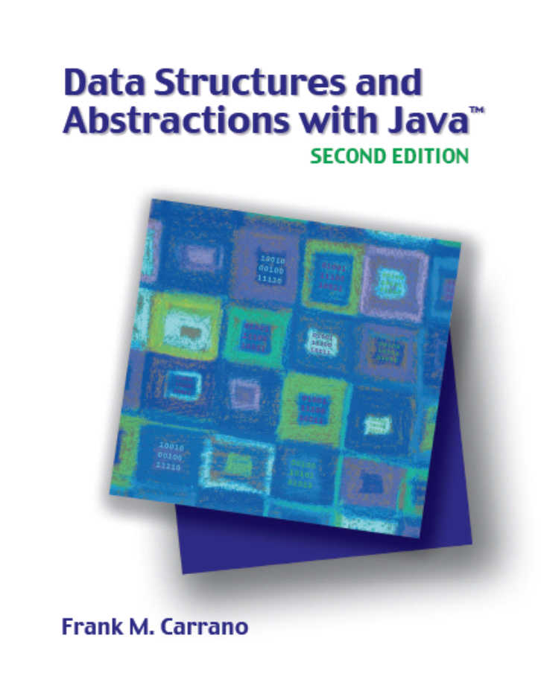

A List Implementation
That Links Data
Chapter 6
Slides by Steve Armstrong
LeTourneau University
Longview, TX
© 2007, Prentice Hall

Slide 2
Linked Data
Consider the analogy of desks in a classroom
  Placed in classroom as needed
  Each desk has a unique id, the “address”
  The desks are linked by keeping the address of another chair
  We have a chain of chairs
Carrano, Data Structures and Abstractions with Java, Second Edition, (c) 2007 Pearson Education, Inc. All rights reserved. 0-13-237045-X

Slide 3
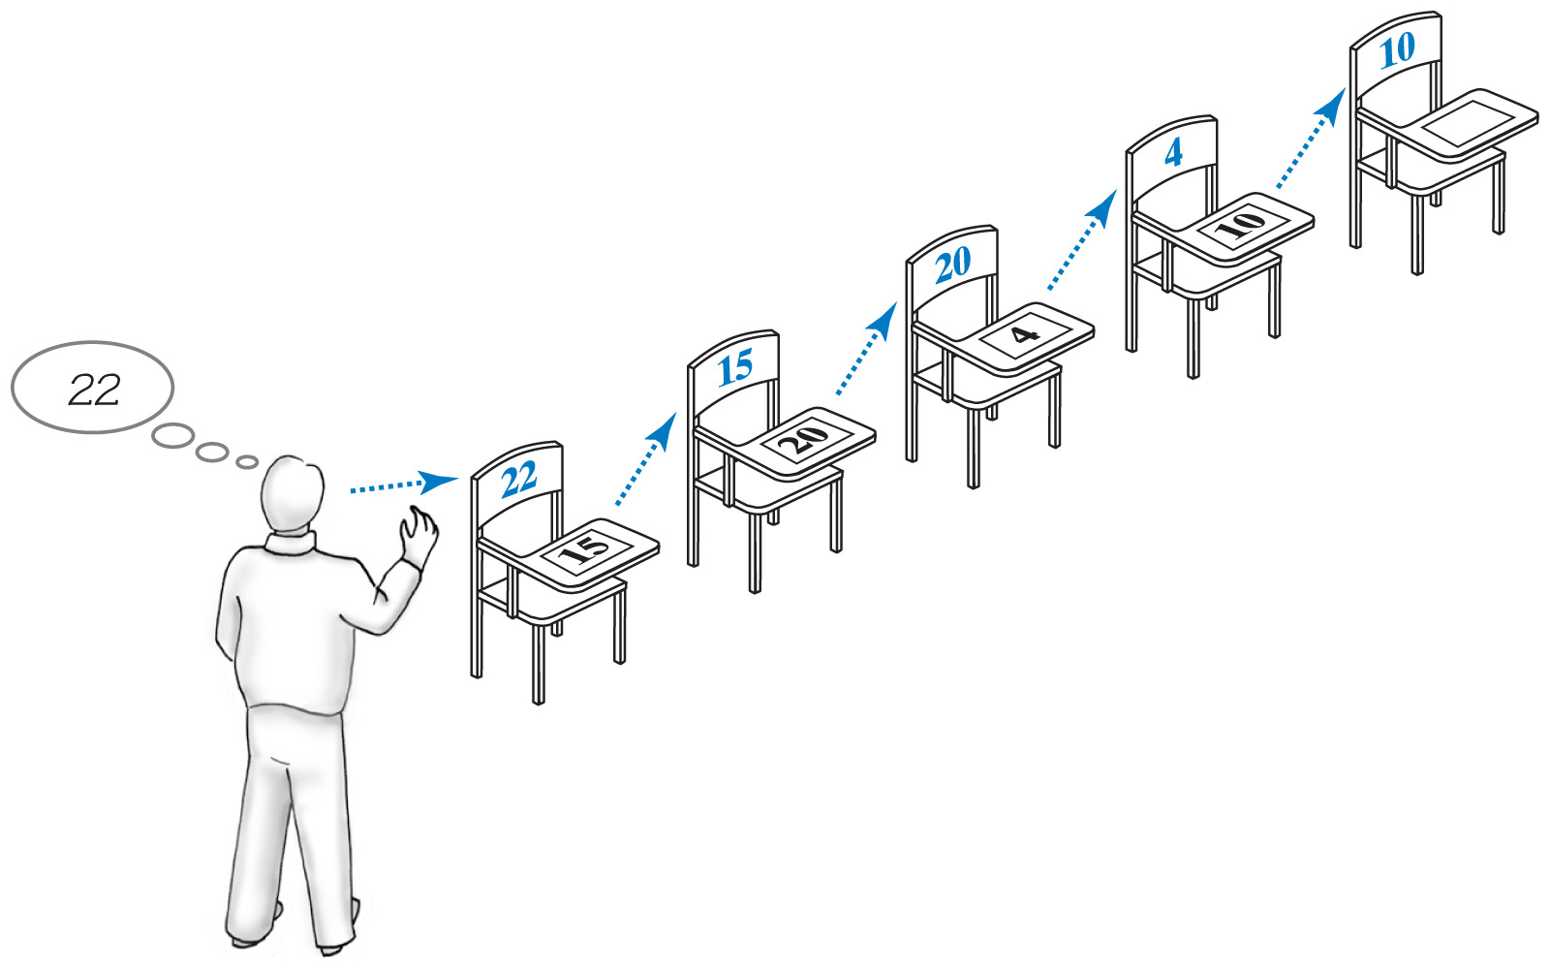
Linked Data
Fig. 6-1 A chain of 5 desks.
Carrano, Data Structures and Abstractions with Java, Second Edition, (c) 2007 Pearson Education, Inc. All rights reserved. 0-13-237045-X

Slide 4
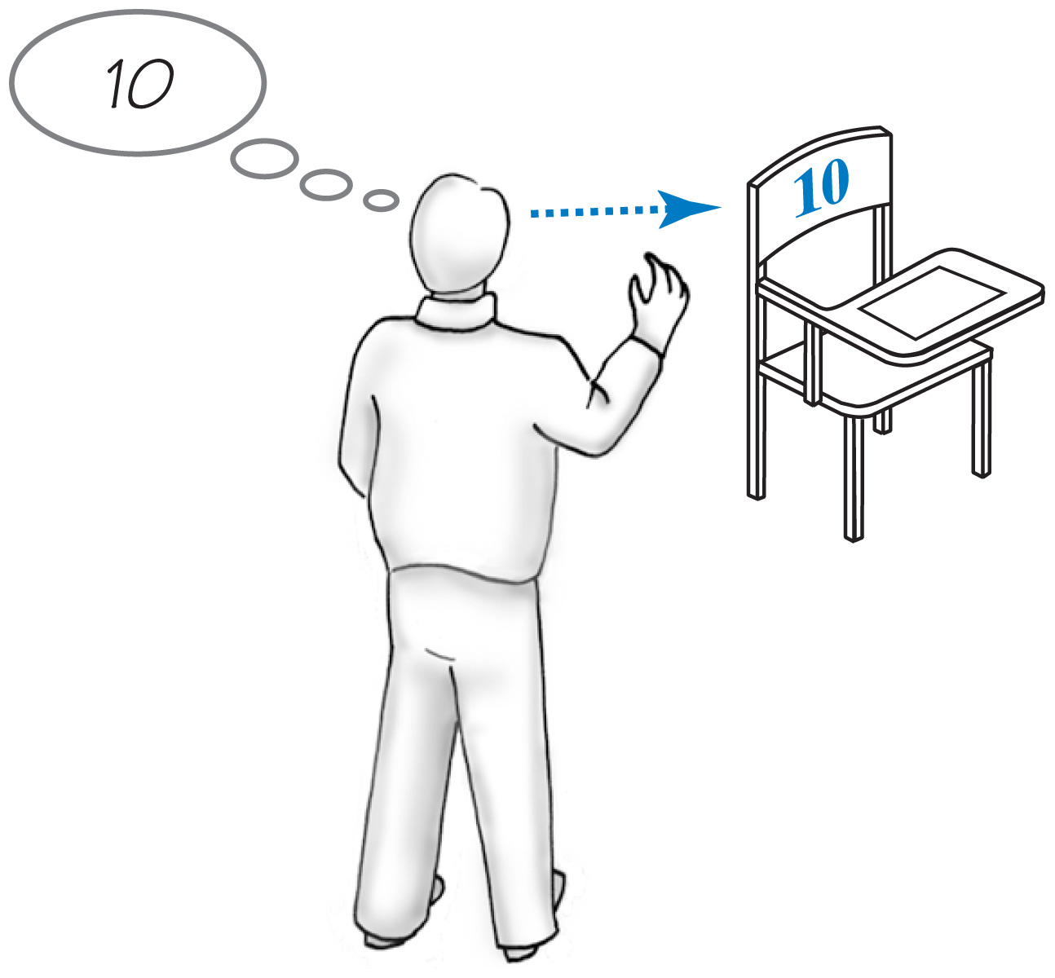
Forming a Chain by Adding to Beginning
First desk placed in room
  Blank desk top, no links
  Address of the first chair given to teacher
Fig. 6-2 One desk in the room.
Carrano, Data Structures and Abstractions with Java, Second Edition, (c) 2007 Pearson Education, Inc. All rights reserved. 0-13-237045-X

Slide 5
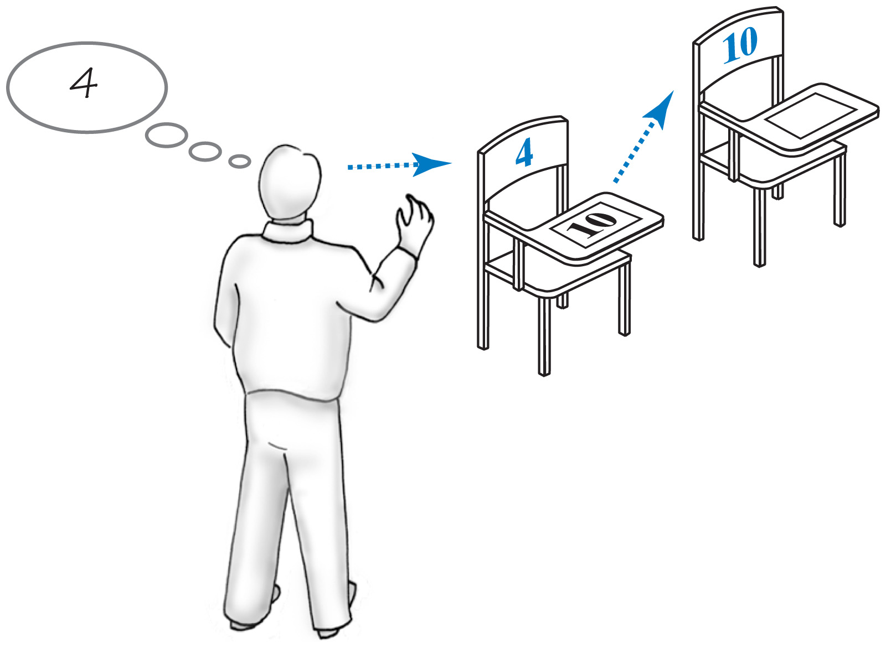
Forming a Chain by Adding to Beginning
Second student arrives, takes a desk
  Address of first desk placed on new desk
  Instructor “remembers” address of new desk
Fig. 6-3 Two linked desks
Carrano, Data Structures and Abstractions with Java, Second Edition, (c) 2007 Pearson Education, Inc. All rights reserved. 0-13-237045-X

Slide 6
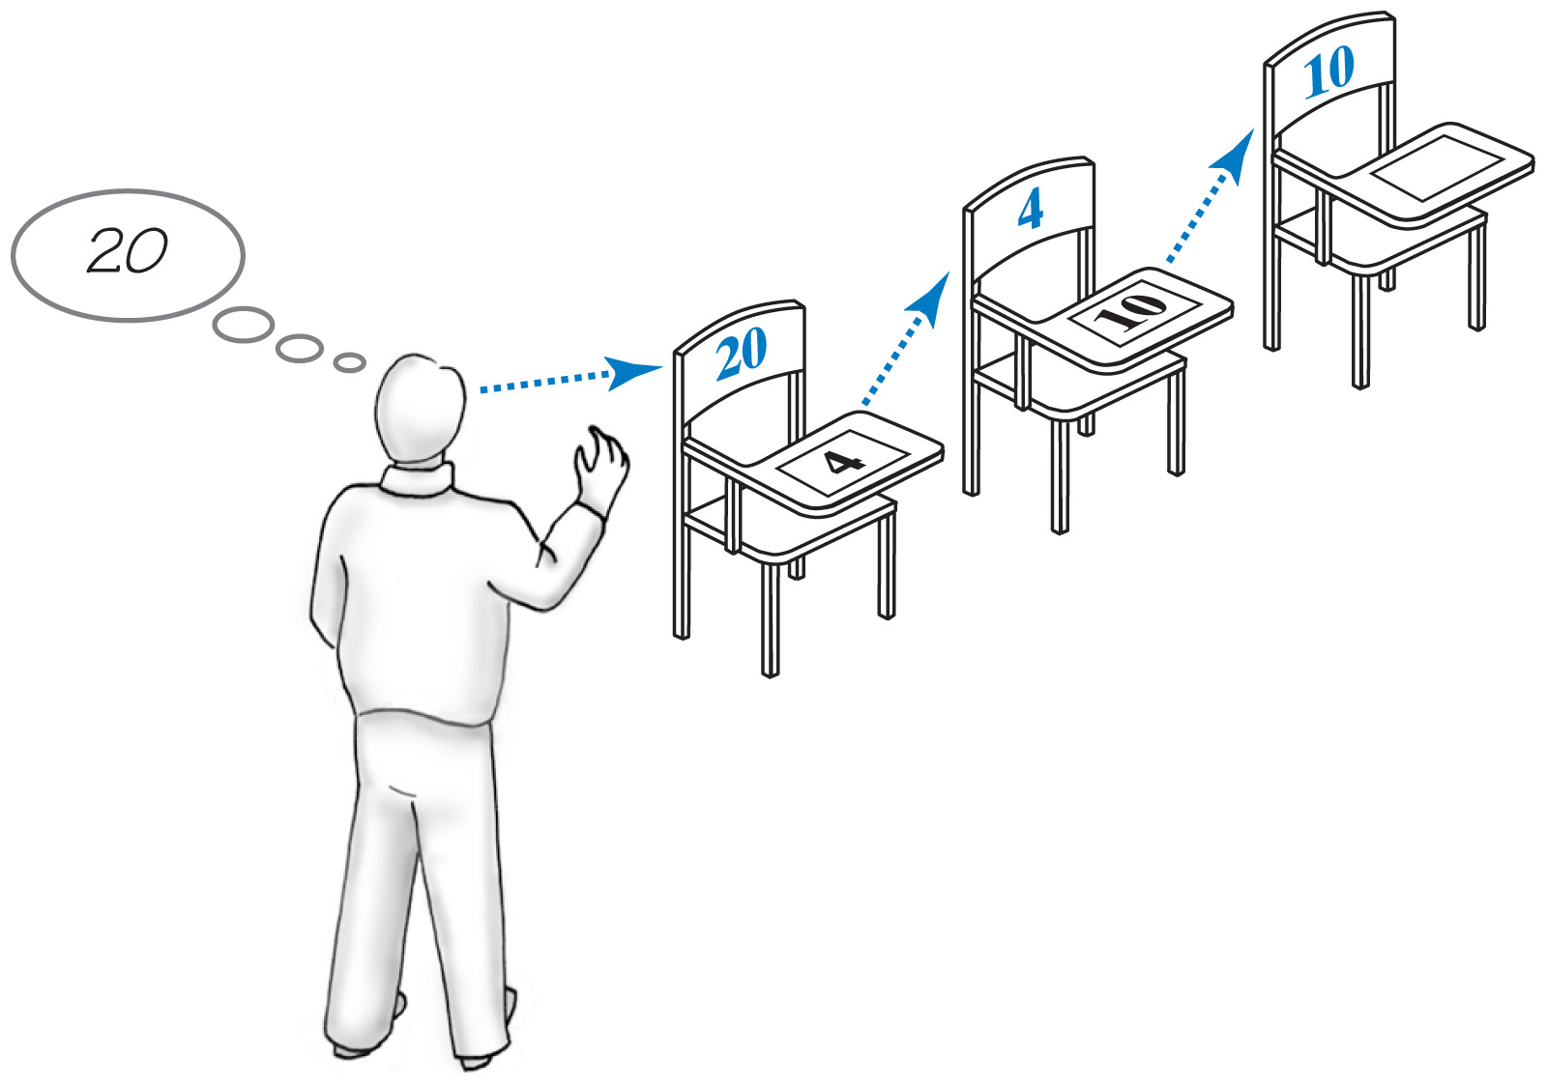
Forming a Chain by Adding to Beginning
Third desk arrives
  New desk gets address of second desk
  Instructor remembers address of new desk
Fig. 6-4 Three linked desks, newest desk first.
Carrano, Data Structures and Abstractions with Java, Second Edition, (c) 2007 Pearson Education, Inc. All rights reserved. 0-13-237045-X

Slide 7
Forming a Chain by Adding to End
This time the first student is always at the beginning of the chain
  Instructor only remembers first address
The address of a new desk is placed on the previous desk (at end of chain)
  End of chain found by following links
  Newest desk does not have a pointer address to any other desk
Carrano, Data Structures and Abstractions with Java, Second Edition, (c) 2007 Pearson Education, Inc. All rights reserved. 0-13-237045-X

Slide 8
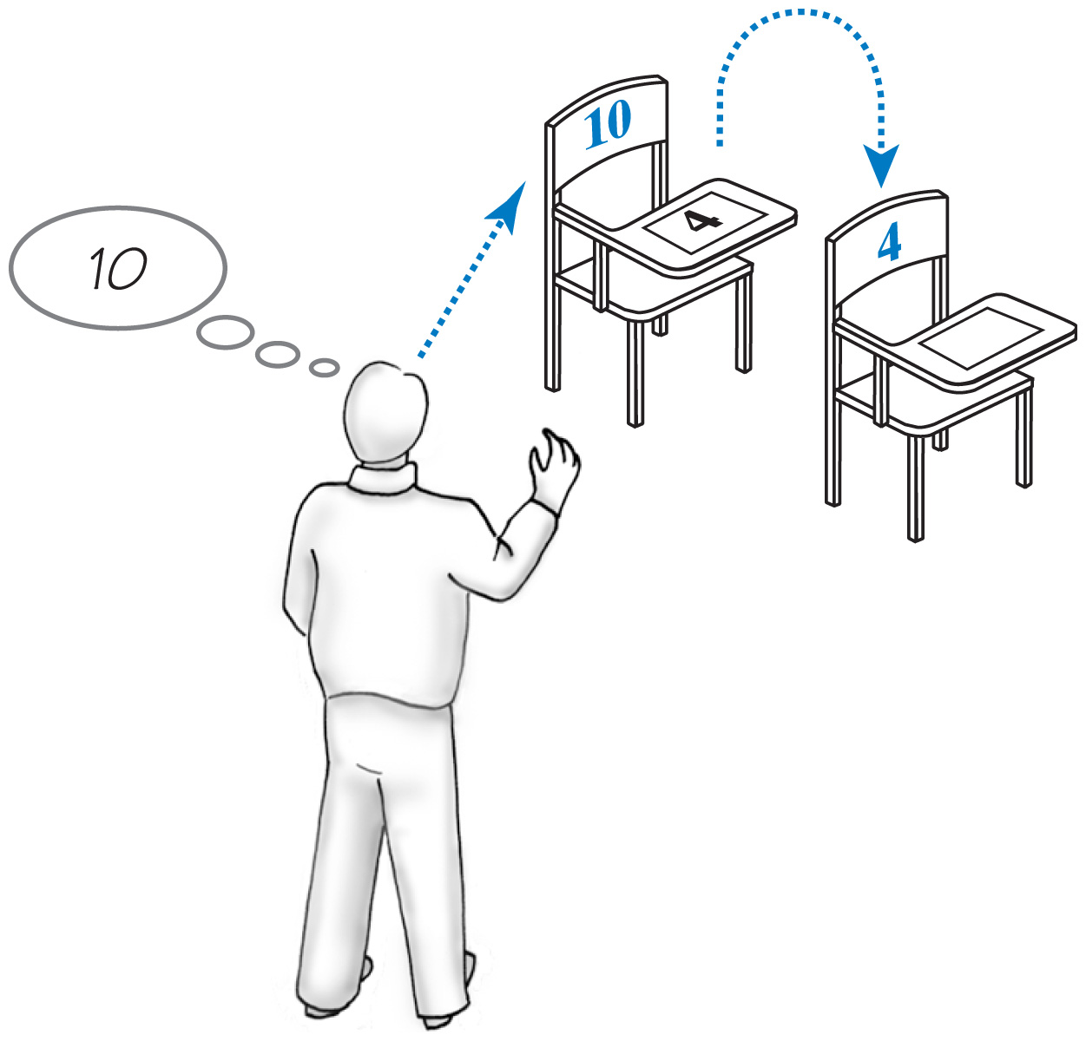
Forming a Chain by Adding to End
Fig. 6-5 Two linked desks, newest desk last.
Carrano, Data Structures and Abstractions with Java, Second Edition, (c) 2007 Pearson Education, Inc. All rights reserved. 0-13-237045-X

Slide 9
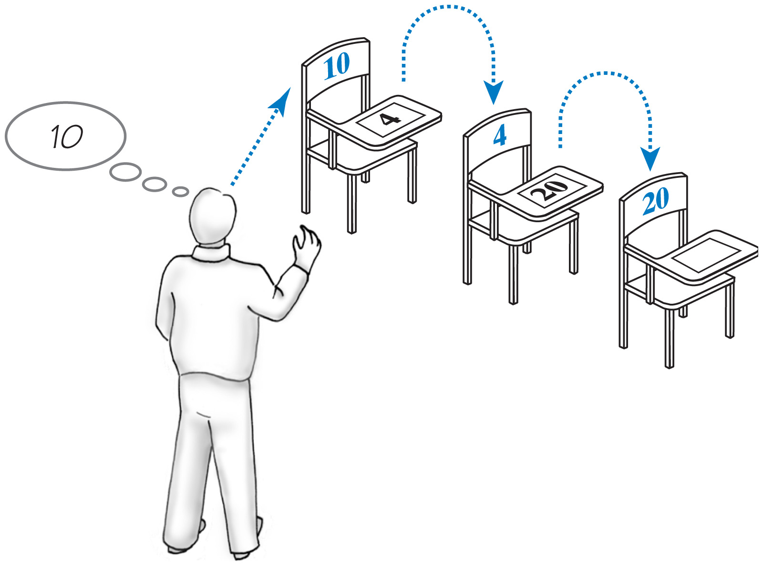
Forming a Chain by Adding to End
Fig. 6-6 Three linked desks, newest desk last.
Carrano, Data Structures and Abstractions with Java, Second Edition, (c) 2007 Pearson Education, Inc. All rights reserved. 0-13-237045-X

Slide 10
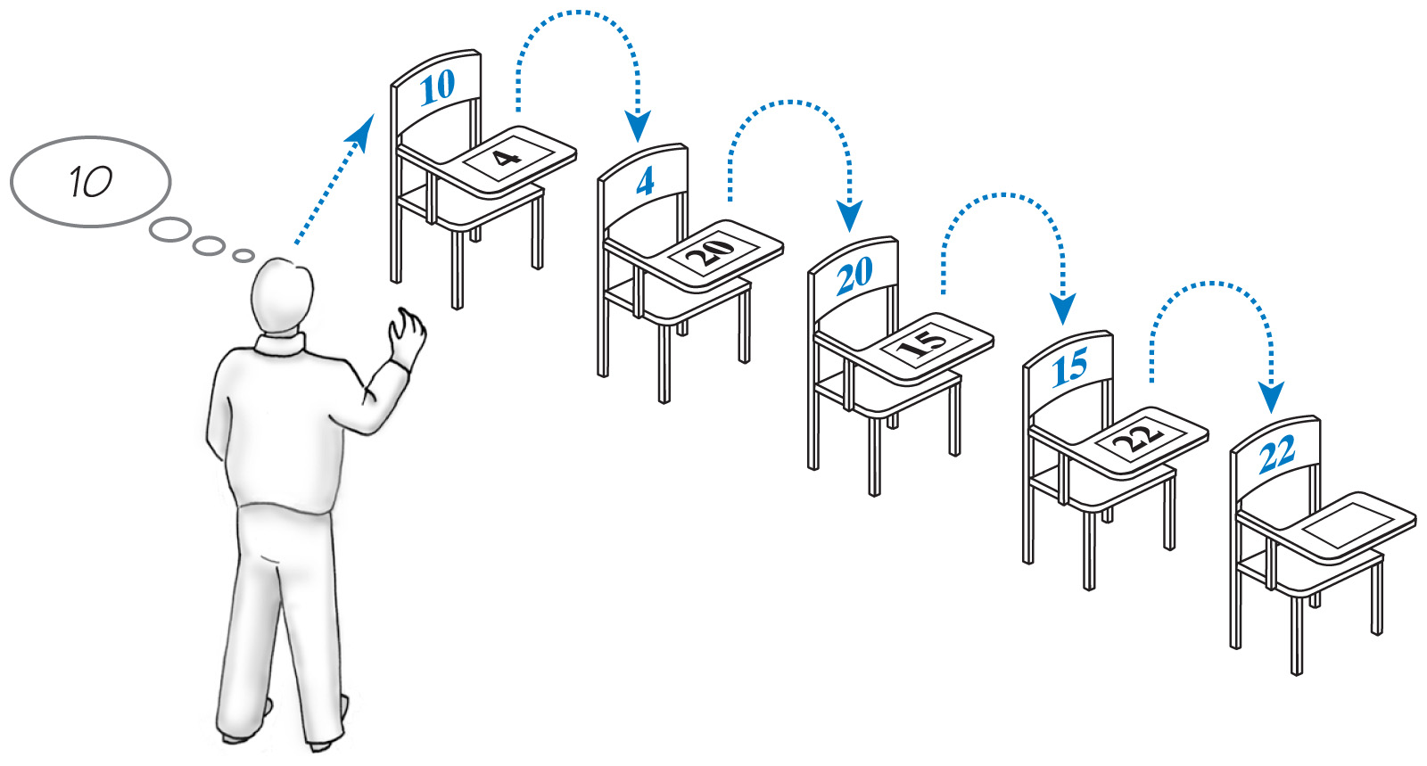
Forming a Chain by Adding to End
Fig. 6-7 Five linked desks, newest desk last.
Carrano, Data Structures and Abstractions with Java, Second Edition, (c) 2007 Pearson Education, Inc. All rights reserved. 0-13-237045-X

Slide 11
Forming Chain by Adding at Various Positions
Consider the requirement to organize the chain chronologically by arrival time
  New arrivals are placed somewhere in the chain, not necessarily at the end
Possibilities for placement of a new desk
  Before all current desks
  Between two existing desks
  After all current desks
Carrano, Data Structures and Abstractions with Java, Second Edition, (c) 2007 Pearson Education, Inc. All rights reserved. 0-13-237045-X

Slide 12
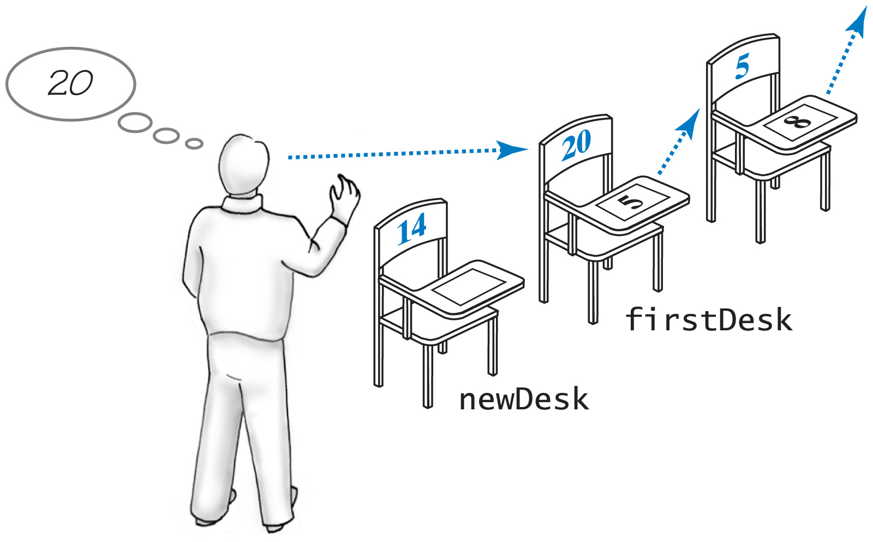
Forming Chain by Adding at Various Positions
Fig. 6-8 Chain of desks prior to adding a new desk to beginning of the chain
Carrano, Data Structures and Abstractions with Java, Second Edition, (c) 2007 Pearson Education, Inc. All rights reserved. 0-13-237045-X

Slide 13
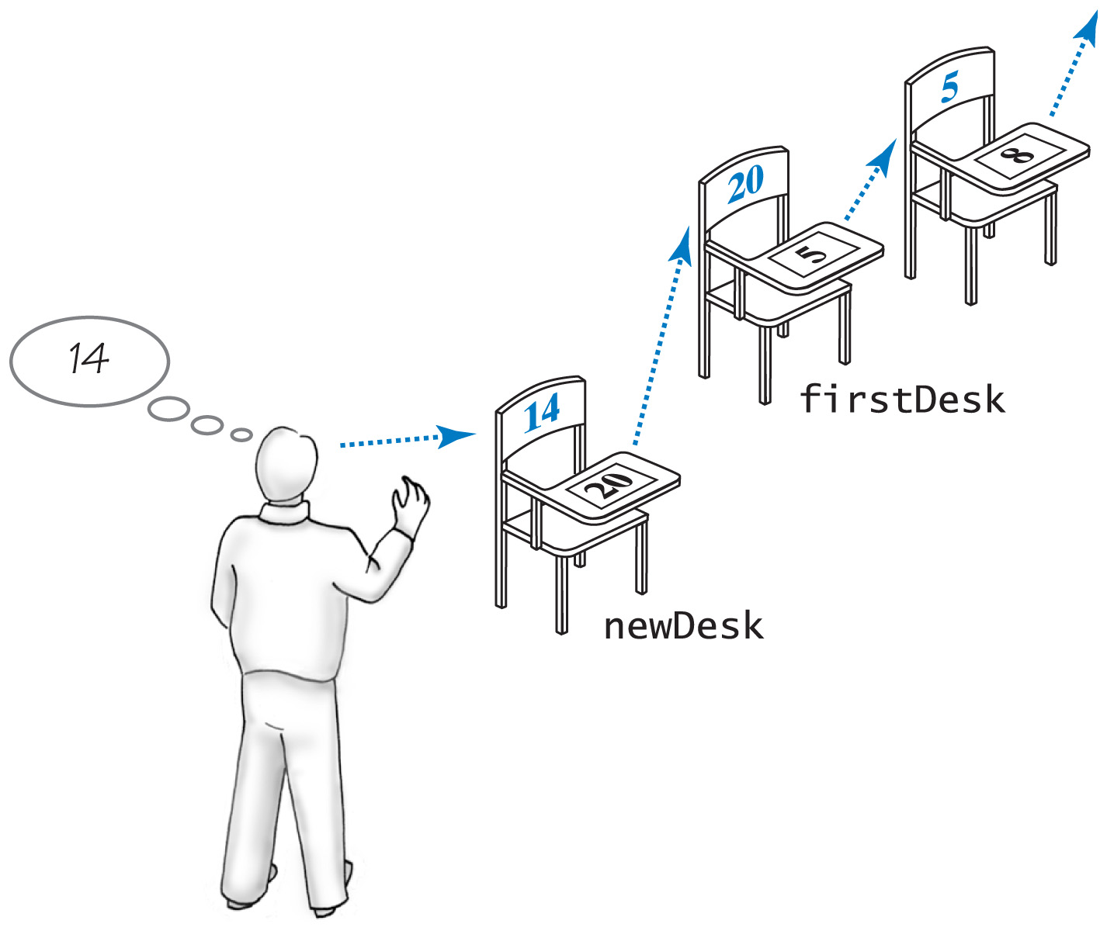
Forming Chain by Adding at Various Positions
Fig. 6-9 Addition of a new desk to beginning of a chain of desks
Carrano, Data Structures and Abstractions with Java, Second Edition, (c) 2007 Pearson Education, Inc. All rights reserved. 0-13-237045-X

Slide 14
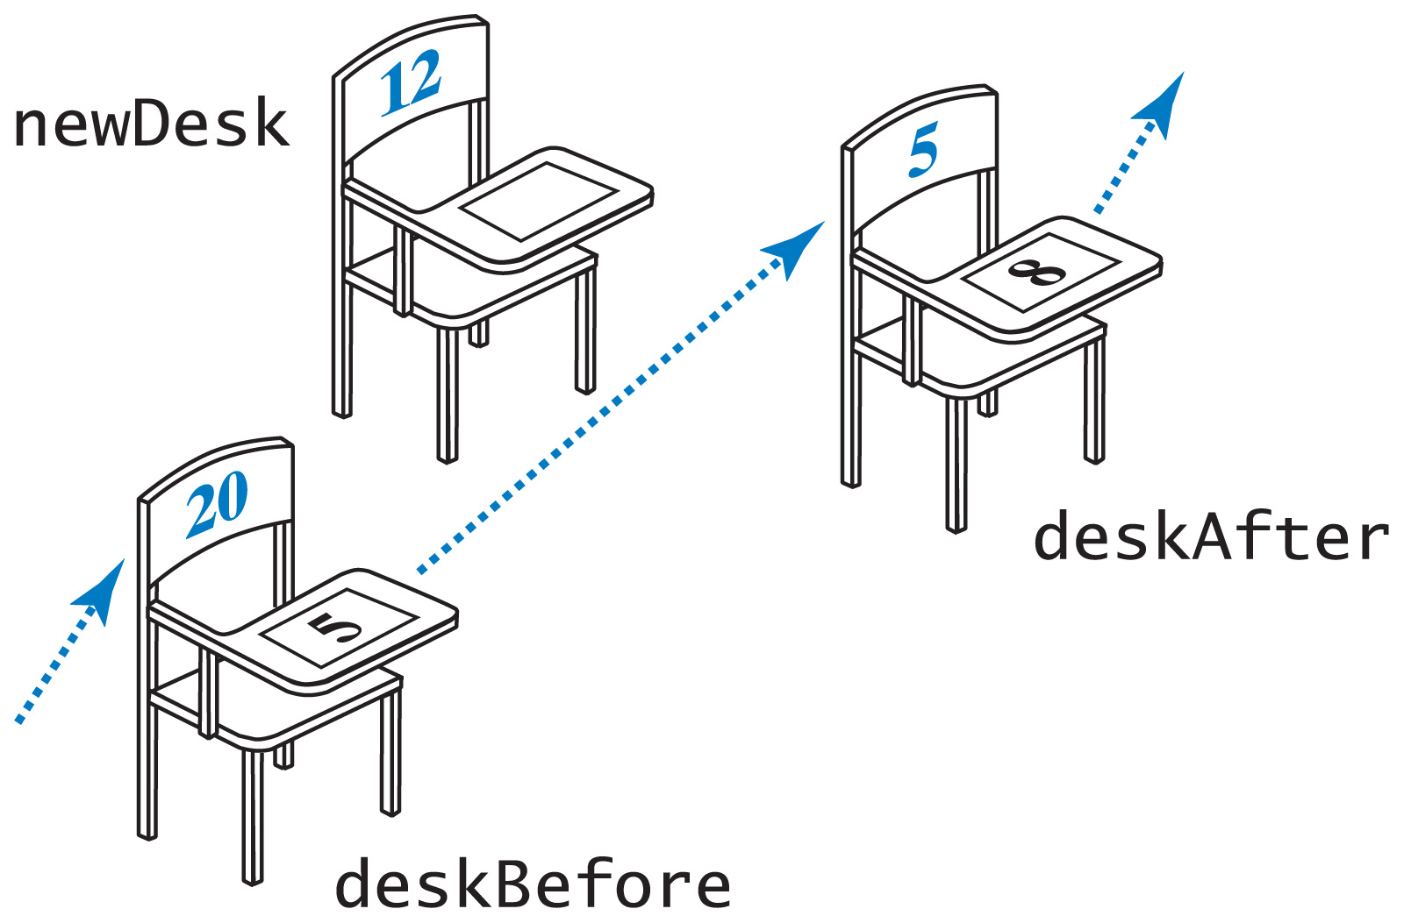
Forming Chain by Adding at Various Positions
Fig. 6-10 Two consecutive desks within a chain prior to adding new desk between
Carrano, Data Structures and Abstractions with Java, Second Edition, (c) 2007 Pearson Education, Inc. All rights reserved. 0-13-237045-X

Slide 15
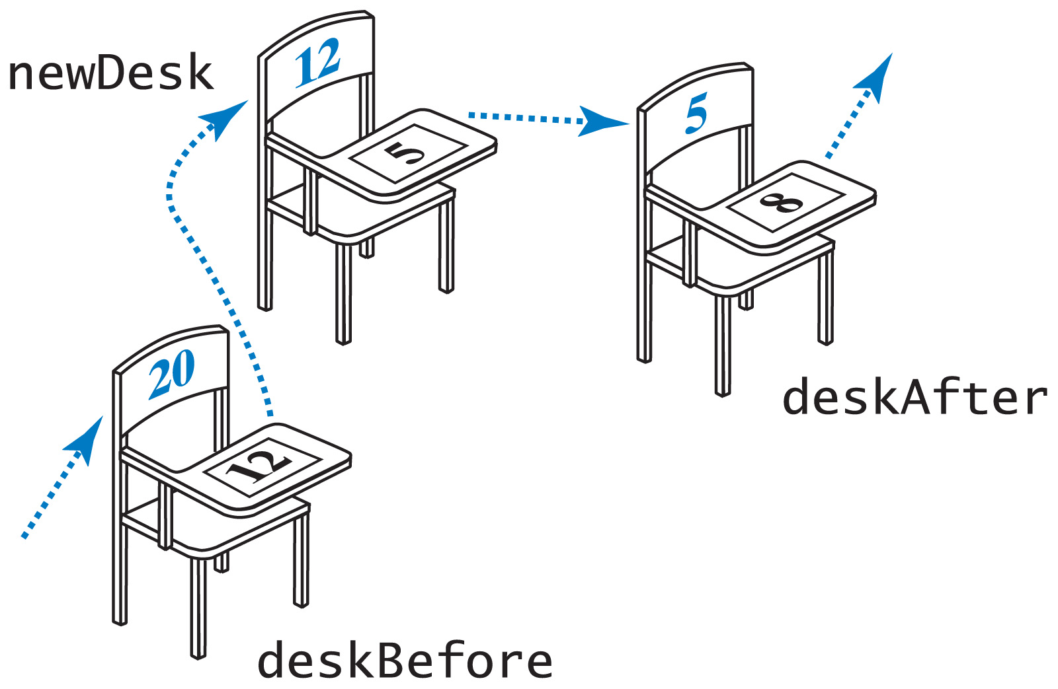
Forming Chain by Adding at Various Positions
Fig. 6-11 Addition of a new desk between two other desks.
Carrano, Data Structures and Abstractions with Java, Second Edition, (c) 2007 Pearson Education, Inc. All rights reserved. 0-13-237045-X

Slide 16
The Class Node
Nodes are objects that are linked together to form a data structure
We will use nodes with two data fields
  A reference to an entry in the list
  A reference to another node
View class definition of Node
Carrano, Data Structures and Abstractions with Java, Second Edition, (c) 2007 Pearson Education, Inc. All rights reserved. 0-13-237045-X

Slide 17
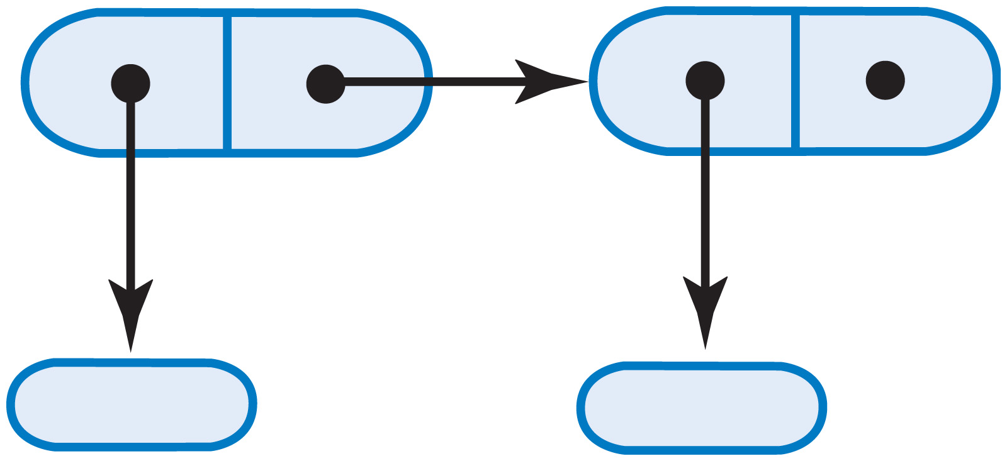
The Class Node
Fig. 6-12 Two linked nodes that each reference object data
Carrano, Data Structures and Abstractions with Java, Second Edition, (c) 2007 Pearson Education, Inc. All rights reserved. 0-13-237045-X

Slide 18
A Linked Implementation of the ADT List
Use a chain of nodes
  Remember the address of the first node in the chain
Record a reference to the first node
  The “head reference”
Carrano, Data Structures and Abstractions with Java, Second Edition, (c) 2007 Pearson Education, Inc. All rights reserved. 0-13-237045-X

Slide 19
Choosing a Core Group of Methods
Must be able to create the collection
  Need method add()
Desire to see objects that have been added to the list
  Need method display()
Constructor also necessary
Carrano, Data Structures and Abstractions with Java, Second Edition, (c) 2007 Pearson Education, Inc. All rights reserved. 0-13-237045-X

Slide 20
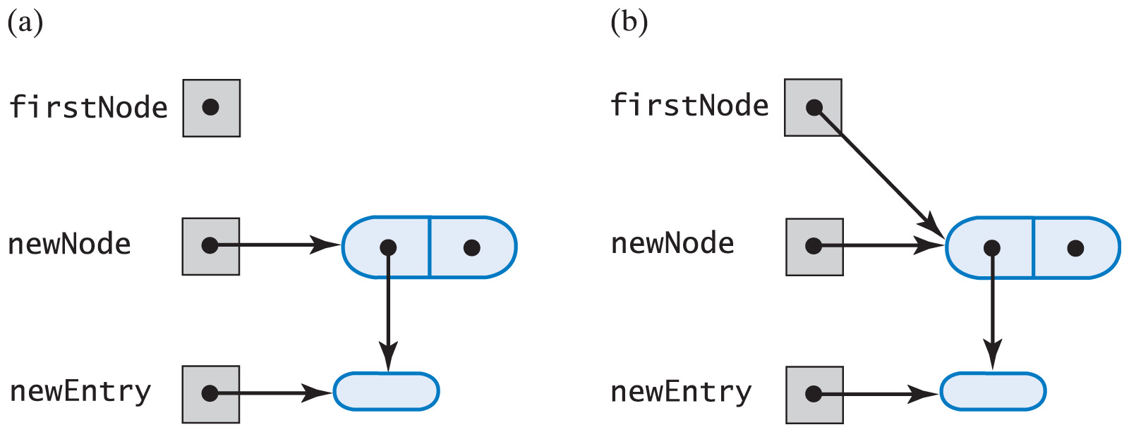
Adding to the End of the List
Fig. 6-13 (a) An empty list and a new node;
(b) after adding a new node to a list that was empty
Carrano, Data Structures and Abstractions with Java, Second Edition, (c) 2007 Pearson Education, Inc. All rights reserved. 0-13-237045-X

Slide 21
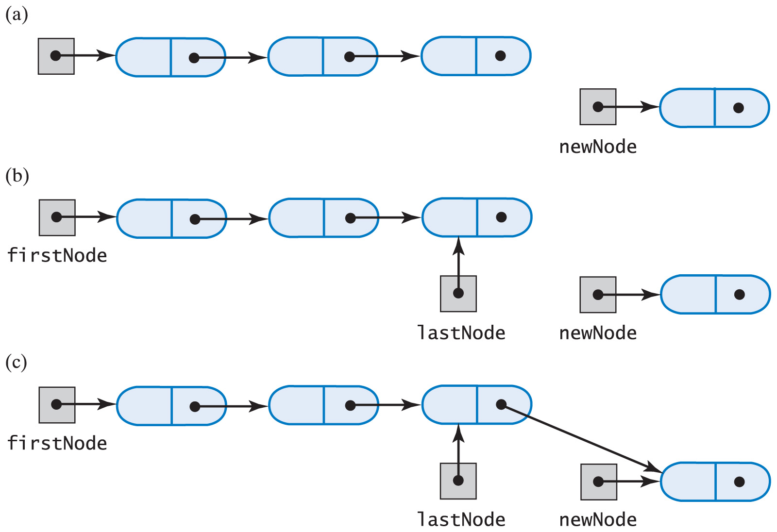
Adding to the End of the List
Fig. 6-14 A chain of nodes (a) just prior to adding a node at the end; (b) just after adding a node at the end.
Carrano, Data Structures and Abstractions with Java, Second Edition, (c) 2007 Pearson Education, Inc. All rights reserved. 0-13-237045-X

Slide 22
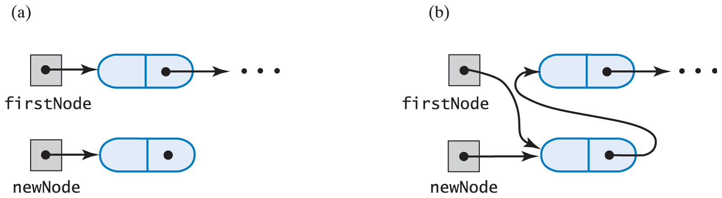
Adding at Beginning of the List
Fig. 6-15 A chain of nodes (a) prior to adding a node at the beginning; (b) after adding a node at the beginning.
Carrano, Data Structures and Abstractions with Java, Second Edition, (c) 2007 Pearson Education, Inc. All rights reserved. 0-13-237045-X

Slide 23
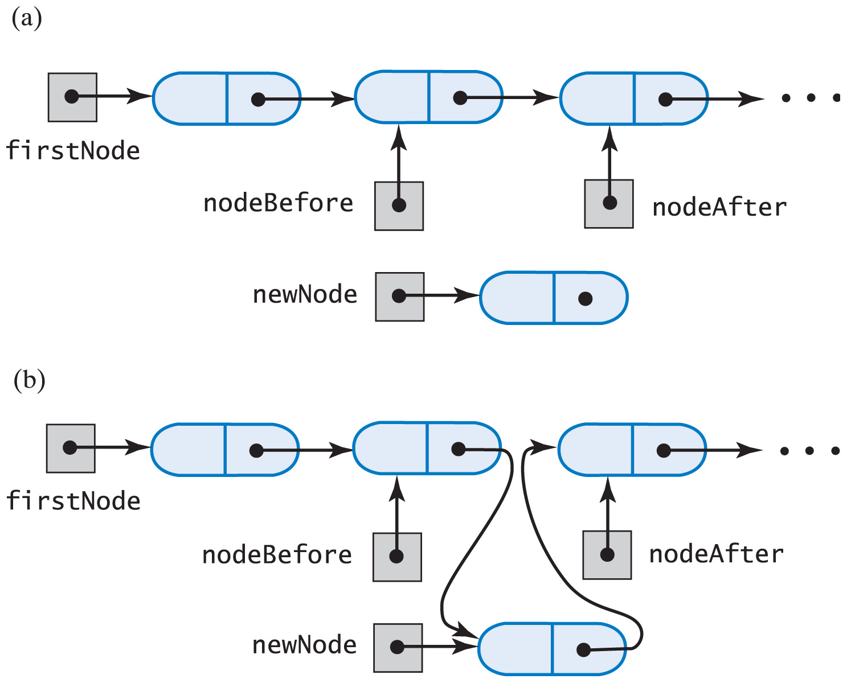
Adding at a Given Position Within the List
Fig. 6-16 A chain of nodes (a) prior to adding node between adjacent nodes; (b) after adding node between adjacent nodes
Carrano, Data Structures and Abstractions with Java, Second Edition, (c) 2007 Pearson Education, Inc. All rights reserved. 0-13-237045-X

Slide 24
Other Core Methods Implemented
Method display()
  Sends output to System.out
Private method getNodeAt()
Carrano, Data Structures and Abstractions with Java, Second Edition, (c) 2007 Pearson Education, Inc. All rights reserved. 0-13-237045-X

